Slide 1


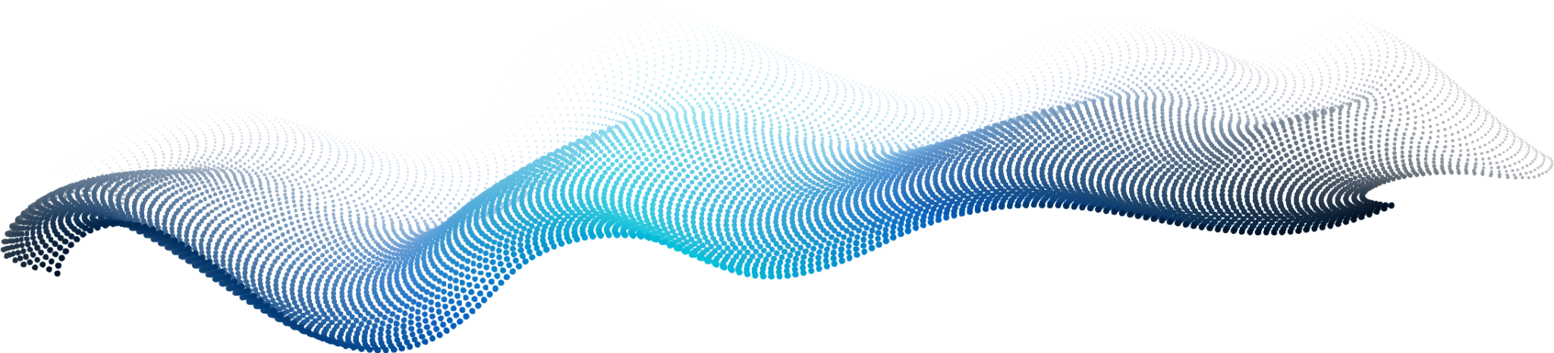
Mechanics of
Torsion
From Theory to Experimental Analysis
BY - Soham Jain (2425050037)
Atharva Tiwari (2425050023)

Slide 2
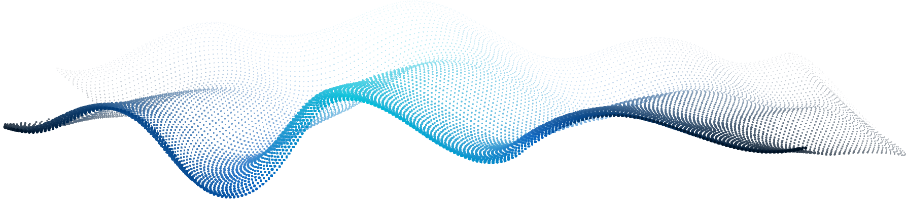
TABLE OF CONTENTS
01
What is Torsion
02
Experimental Setup
What torsion actually is and its
Real-life relevance
You can describe the topic of the section here
03
Working Principle & Procedure
04
Results, Applications & Conclusion
You can describe the topic of the section here
You can describe the topic of the section here
You can describe the topic of the section here
You can describe the topic of the section here

Slide 3
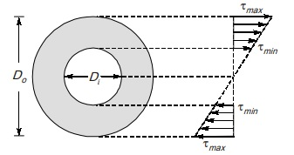

What Is Torsion?
Torsion is the twisting of a structural member when a torque is applied.
Caused by a moment acting about the longitudinal axis.
Produces shear stress inside the material.
Common in shafts, wires, tools, couplers, and rotating machinery.

Slide 4
How Torque Creates Twisting?
Torque (T) is a rotational force applied at a distance from the axis.
When torque is applied, the material experiences internal resistance to twisting.
This resistance generates shear stresses inside the cross-section.
Higher torque → greater twist, until the material’s limit is reached.

Slide 5
Shear Stress in Torsion
When a material is twisted, it develops shear stress (τ) over its cross-section.
Shear stress increases linearly from the center to the outer surface.
Maximum shear stress occurs at the outer radius (r).
τ = T × r
J
--------------
Here -
T = Applied torque
r = Radius from center
J = Polar moment of inertia shape)

Slide 6
Angle of Twist (θ)
Angle of twist tells how much the shaft/wire rotates under torque.
Depends on the material, length, geometry, and applied torque.
Higher torque or longer specimen = greater twist.
Stiffer material (higher G) = less twist.
θ = T × L
G × J
-----------------
Here -
T = Applied torque
L = Length of the specimen
G = Modulus of rigidity
J = Polar moment of inertia

Slide 7
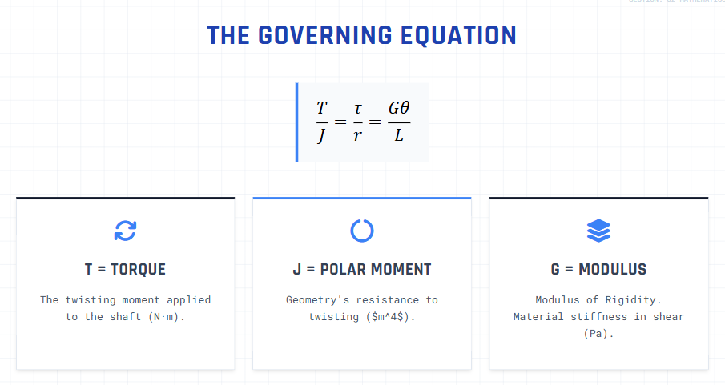

Slide 8
Experimental Setup
(Each component is chosen to safely apply torque and measure twist accurately).

Slide 9




Components
12V 10 RPM motor
BTS7960
Arduino Nano
Low speed → controlled twisting
high-current motor driver
for control + data handling
Custom wood chassis
for mounting and stability

Slide 10


Why These Sensors?
Angle Sensor
Current Sensor
Measures rotation / twist of the wire.
Gives real-time angle data to Arduino.
Used to calculate angle of twist (θ).
Measures motor current draw during twisting.
Higher current = higher applied torque (T).
Helps estimate torque–twist relationship.
Together they form the basis of torsion analysis.

Slide 11
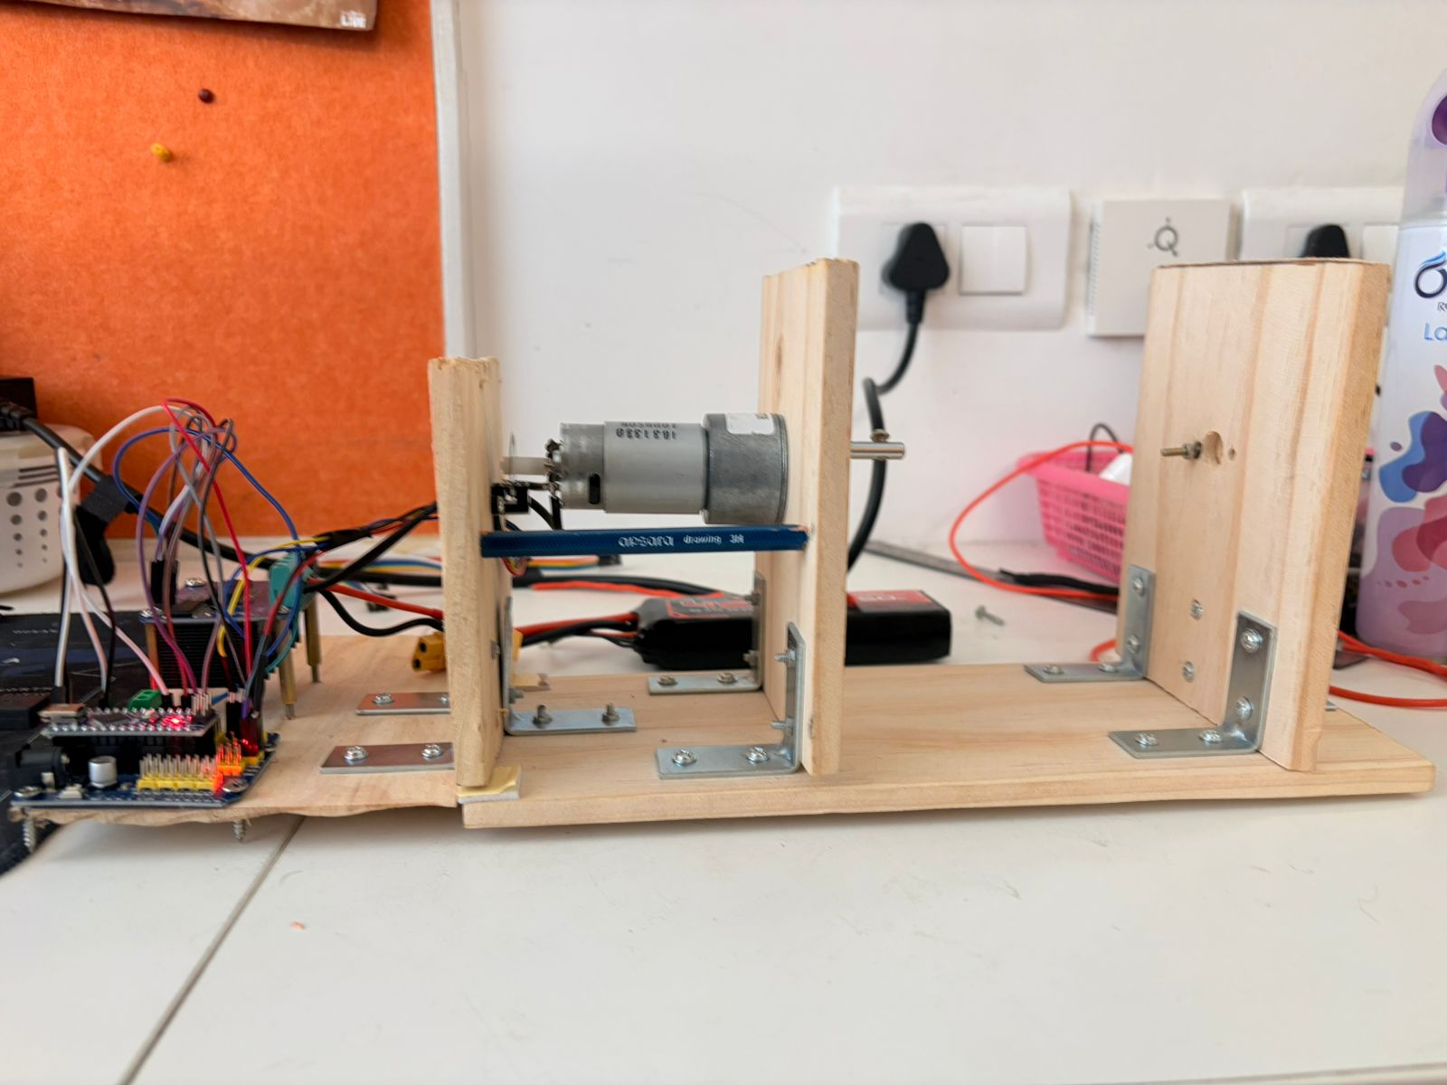
Test Rig
Wooden chassis built for stable and vibration-free operation.
Motor firmly mounted to prevent any movement during twisting load.
Rotating end attached to the motor shaft for applying torque.
Sensors positioned close to the motor for accurate readings.
Wiring and battery placement done to avoid interference with rotation.

Slide 12
Working Flow of System
Motor applies torque to the wire.
Wire (16 AWG) undergoes twisting as torque increases.
Angle Sensor measures twist / rotation of the wire.
Current Sensor measures motor load → torque estimation.
Arduino Nano Reads angle & current data and Controls motor through BTS7960
Logs/outputs measured values
Power Source (11.1V Li-Po) supplies motor + control electronics.

Slide 13
Working Princriple of System
The motor rotates at low RPM to apply gradual torque on the wire.
One end of the wire is fixed, the other end is twisted by the motor.
As torque increases, the wire experiences shear stress and begins to twist.
The angle sensor measures how much twist (θ) occurs.
The current sensor detects increased current as torque demand rises.
Arduino reads both sensors → gives real-time twist vs torque behavior.
System ensures controlled twisting without sudden load spikes.

Slide 14
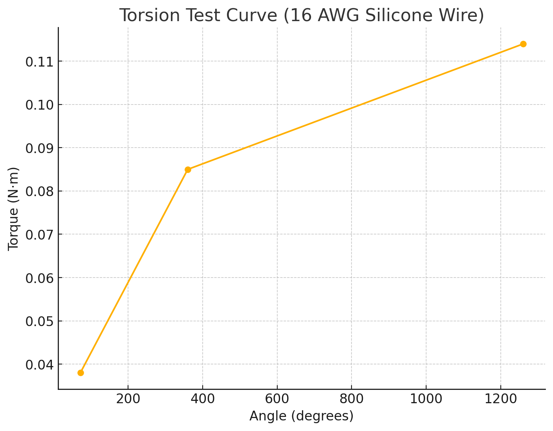
Expected Material Behavior Under Torsion
Linear Elastic Region
Twist increases proportionally with torque.
Material returns to original shape when torque is removed.
Non-Linear Region
Material starts losing stiffness.
Twist increases faster for the same torque.
Internal structure begins to deform.
Yield / Failure Region
Permanent twisting or distortion occurs.
Wire may neck, soften, or break depending on load.
Current spikes sharply due to sudden resistance drop.

Slide 15
Applications Conclusion
Used in drive shafts, axles, and couplings.
Essential in robotics: joints, grippers, torque transmission.
Found in tools: screwdrivers, torsion bars, wrenches.
Important in structural and mechanical design for load analysis.
Torsion explains how materials behave under twisting loads.
The experiment demonstrates real-time twist vs torque behavior.
Angle + current measurements help understand material deformation.
A clear understanding of torsion is critical in mechatronics and mechanical systems.

Slide 16
Thank You

Slide 17



THREE IDEAS
MERCURY
VENUS
MARS
Mercury is the closest planet to the Sun and the smallest of them all
Venus has a beautiful name and is the second planet from the Sun
Despite being red, Mars is actually a cold place. It’s full of iron oxide dust

Slide 18


PRODUCT DEMO
You can replace the image on the screen with your own work. Just right-click on it and select “Replace image”

